Slide 1
Home Automation Walkthrough

Slide 2
1.
What problem are we solving?
A Brief Overview

Slide 3
Who are the users? And how are we going to solve their problems?
These end users are the people most affected by this system, and in turn makes them a stakeholder. Another stakeholder has to be the company that ensures a secure connection to your home devices and protects them from external actors and protects your personal data. These stakeholders generally want an efficient and intuitive way to interact with their home automation devices and have a distinct need to be able to create their own unique setup. The problems this system will solve is the depth of customization that modern-day home automations generally lack and will also aid in securing a clean outlook for the interaction within the app itself.

Slide 4
2.
Who are our users?
Their goals, and contexts of use

Slide 5
Our User Groups
O Stakeholder: The end users that interact with the system through the mobile/web application. The other stakeholder are the people involved in the security and custodians of your data.
O Primary users: Tech-savvy people that are going to be using the system to automate certain processes within their home.
O Secondary Users: Guests/family that visit or live there
O Tertiary users: Interior designers and business owners influence its purchase, customers within a business building would be influenced by the purcha

Slide 6
User Characteristics
Educational Level: | High school graduate or above
Computer Expertise: | Basic, competent users that know how to interact with user interfaces, and know how to navigate through applications
Age Range: | 18-30
Frequency of use: | They will use this interface frequently as they need to be able to turn lights on and off daily, and to control various other appliances.

Slide 7
What do the users want to do with the system?
The users will utilize the system to control basic household items such as lights, house locks, television, security cameras from anywhere using the application from any device (Smart phones, computers, etc.).

Slide 8
Functional Goals
o Connect different smart home devices through the app
o Have the equipment give feedback through accomplished tasks
Display and allow the change of state of smart home devices when given commands. For example, you turn off your lights through the UI when a button is pressed, or you activate voice assistant through your phone
o Allow customization of the list of devices and their specific attributes.
o Allow for remote security device monitoring, and security camera viewing, and prompting through the app.
o Check logs for different device usage/data (Allows for monitoring power consumption and other information about devices)

Slide 9
Non-Functional Goals
o Latency between user monitoring security cameras should not be more than 1 minute at all times.
o If the app is being used outside of home’s range, it should take no more than 30 seconds to react. (Locking the door, turning off lights, etc.)
o Send an alert within 1 minute after unauthorized entrance of home/motion detection..

Slide 10
Are there any environmental factors that would affect how the user uses the system?
· Being present in the house could affect the direct use of a home automatic system.
· Access to wireless broadband

Slide 11
3.
What tasks do we have to do to meet these goals?

Slide 12
Task 1:
Objective:
Have the equipment give feedback through accomplished tasks
Tasks:
Scroll to the desired category (Security, appliances, casting, or smart speakers)
Click on chosen device that you wish to manipulate
Choose the goal that you wish to achieve

Slide 13
Task 2:
Objective:
Allow customization of the list of devices and their specific attributes
Tasks:
Scroll to the desired category (Security, appliances, casting, or smart speakers)
Click on chosen device that you wish to manipulate
Click on the settings button and customize the device (the three dots in the top right corner)

Slide 14
Task 3:
Objective:
Grant access to data records on home automation categories
Tasks:
Click the home data button(shown at the top of the app), then click the category you’d like to get data from
Click and manipulate data to see based on time restrictions, highest usage, etc.

Slide 15
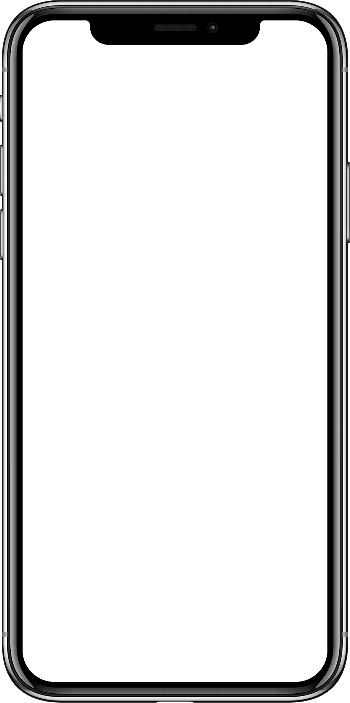
uhome
Low-fidelity prototype
This opening page here is how we introduce our new user to the most important function of the app, adding a device.
Our conceptual model shows how to use the functions within the app though the grouping of alike devices within categories that are also split from each other. We show affordance through the types of varied shapes that we utilize, this is shown through having circular shaded/colored buttons and a unique shape for the highlighted unique functions within the main page’s top header, for example the device data button will be found at the top of the main page with a unique set of characteristics to distinguish it from regular category functions in the app.
Get Started
+
Add your device

Slide 16




uhome
uhome
Task 1: Clicking on desired device
You can go to your desired device by scrolling down the home page to “My Devices” and picking out your device from the many different categories
Internal Consistency : “uhome” logo is always the home button across the application.
External Consistency: Power button is universally known as the on/off switch.
Feedback: When a button is clicked Button has a light gray shadow indicating its been clicked
Constraints: Scroll Indicator is a visibility constraint (Only shows up when scrolling)
Light 1
Function 1
Function 2
Turn on Lights
Set Off Timer
-
My Devices
Light 2
Lights
Turn on Lights
Device
image
Device
image
-
Set Off Timer
Light
Device 2 name
More button

Slide 17

Task 2: Click on the settings button and customize device
External Consistency: The slider button is universally known as the on and off switch within device settings
Feedback: The switch toggle moves to the right when on, and switches to the left when turned off.
Constraints (Information-based): Advanced settings are hidden from the user to make sure app security and integrity stays in tact.
Click on the settings through the more button and customize the device (the three dots in the top right corner)
uhome
uhome
Window Camera
My Devices
Save recordings to device
Smart Speakers
Notify device when external movement is seen
Device 1
image
Device 2
image
Doorbell
Pcuk-sized Speaker
Doorbell Camera
Provide live feedback to camera when activated
Appliances
Notify when unlocked

Slide 18
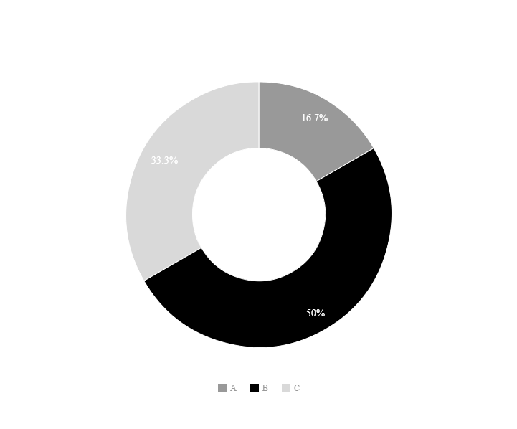

uhome
uhome
Task 3: Home Data Button
External Consistency: The arrow keys on the bottom are known across platforms as image sliders.
Feedback: Clicking the arrow keys will result in changing the page.
Constraints (Actual restriction): User is only able to view one datagraph at a time because of the graphs being clickable for more information.
Home Data
Home Data
Function 2
Power Usage
My Devices
Click Home Data Button
Category 1
Device 1
image
Device 2
image
Device 1 name
Device 2 name

Slide 19
Thank you for listening!
Please feel free to do the questionnaire!

